Slide 1
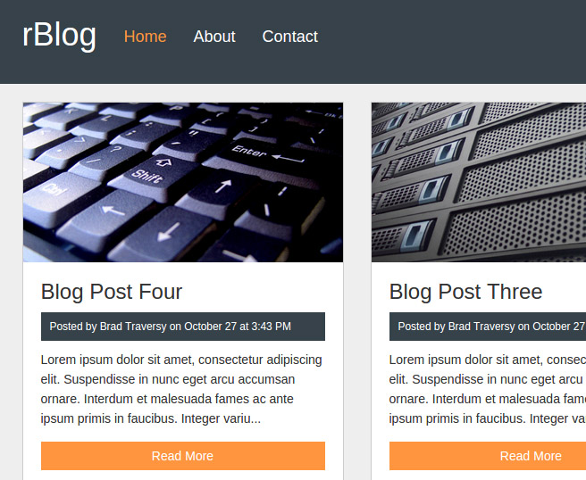
Projects Using Ruby on Rails
Project 2 Intro – rBlog Blogging System

Slide 2
Project Description & Features
Full featured blogging system
Posts with categories
Commenting system
Backend admin area
Custom user management system
Login
RESTful routing

Slide 3
Project Sections
Section 1: Project Introduction
Section 2: Building the rBlog UI
Section 3: Setup Controllers, Models & Routes
Section 4: Bootstrap Sass Layout
Section 5: Admin CRUD
Section 6: Search & Pagination
Section 7: File Upload & Editor Fields
Section 8: Frontend Posts, Categories & Comments
Section 9: rBlog Login System

Slide 4
What You’ll Learn
SQL3Lite database integration & console
MVC framework fundamentals
CRUD operations in Rails
Bootstrap-Sass Gems
File uploading
Text editor Gem
User login system
Search/filter & pagination

Slide 5
Let’s Do It!
Let’s go code!

